Slide 1
Lab2 (Q3)
Paste() function and for loop (download DEM for watersheds)
3. R for remote sensing image processing

Slide 2
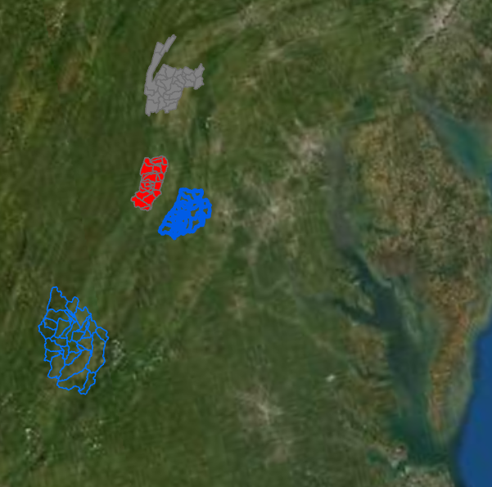
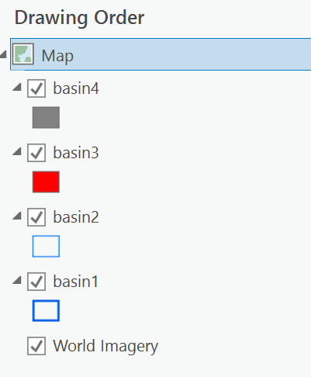
Batch processing GIS data (shapefiles and raster)

Slide 3
paste() function
paste('R','Programming’)
paste(‘R’,’Programming’,sep=‘-’)
id<-1
paste(‘R’,’Programming’,’lab’,id,sep=‘’)
concatenate a series of strings.

Slide 4
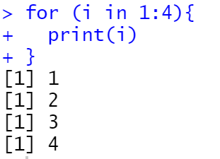
for loop
for (i in 1:4) {
print(i)
}

Slide 5
GIS task: download DEM for each basin
for loop
Generate file names using paste() function
Read shapefile (e.g., basin1s, basin2s…)
FedData library: use get_ned() function to download 30m resolution DEM

Slide 6
Please download the shapefiles from the inclass folder (canvas/inclass/basins)
library(rgdal)
library(raster)
for (i in 1:4) {
filename<-paste(‘basin’,i,sep=‘’);
basin<-readOGR(‘.’,layer=filename)
plot(basin)
}

Slide 7
Within the for loop
#project shapefile to GCS Longlat NAD83
(original projection was ‘AEA projection’ and it does not work well with
FedData library
new_crs='+proj=longlat +datum=NAD83 +no_defs’
basinp<-spTransform(basin,new_crs)

Slide 8
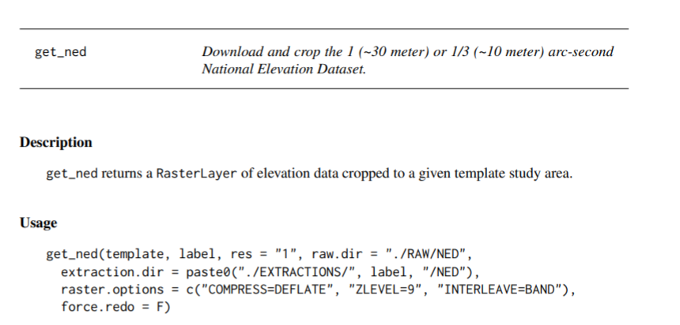
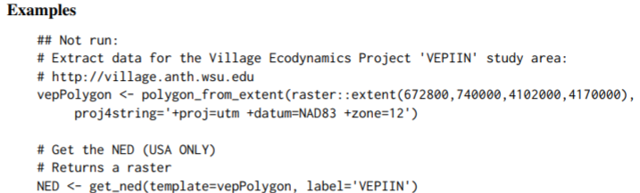
Within the for loop – how to download DEM using get_ned function

Slide 9
Within the for loop
#generate unique label for each basin
basinlabel<-paste('test',i,sep=‘’)
#download dem for each basin
ned<-get_ned(template=basinp, label=basinlabel)
#mask dem using basin shapefile
ned<-mask(ned,basinp)
#write it out; each time using a different file name
outputfile<-paste('dem',i,'.tif',sep='')
writeRaster(ned,outputfile,overwrite=T)

Slide 10
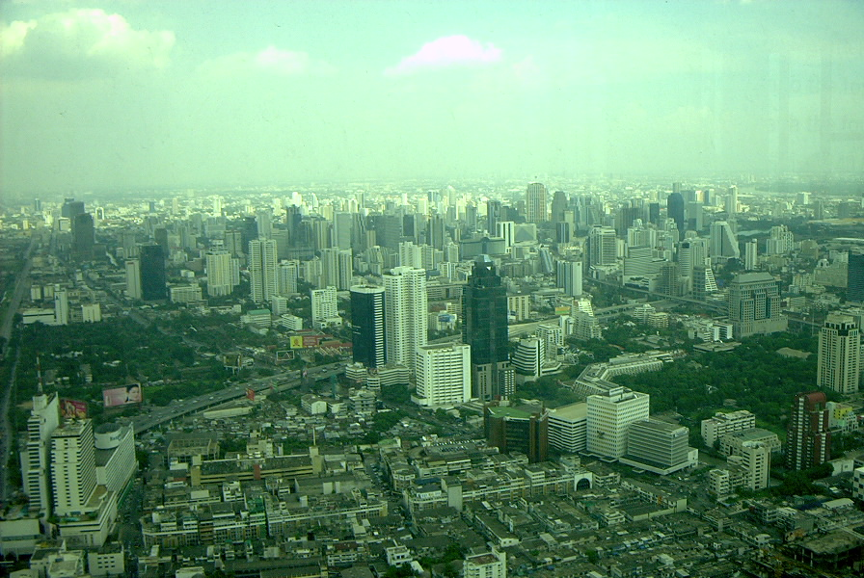
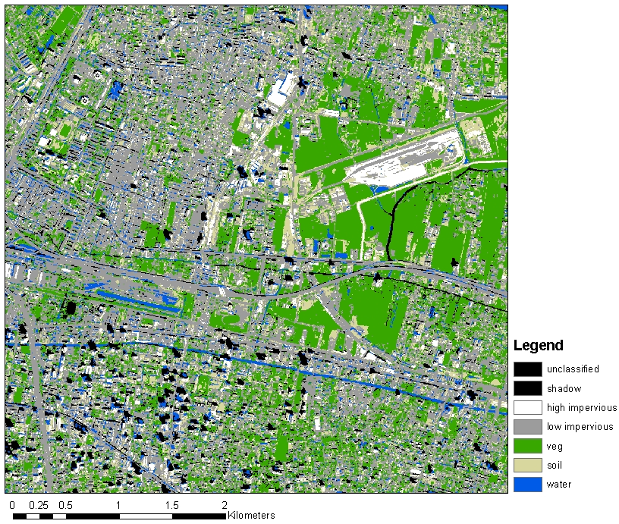
Working with remote sensing image using R

Slide 11
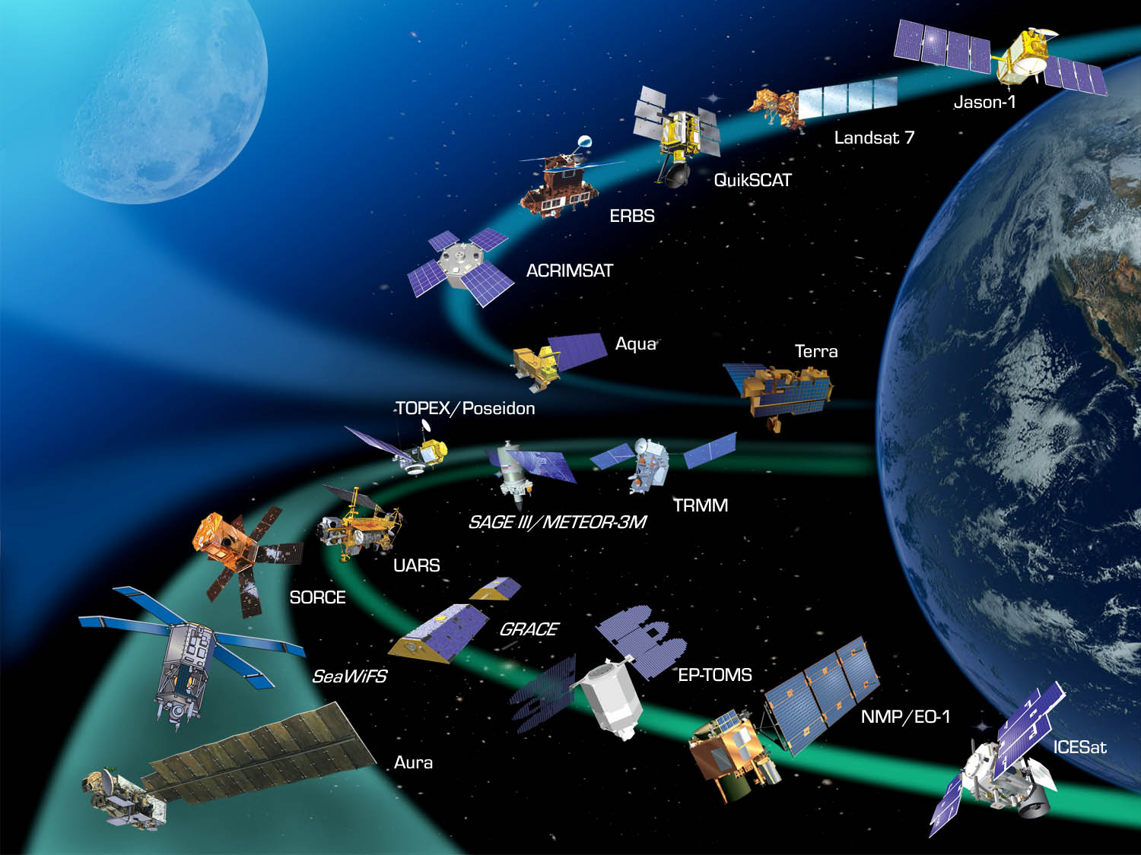
NASA Earth Observatories
Number of Satellites?
2500+

Slide 12

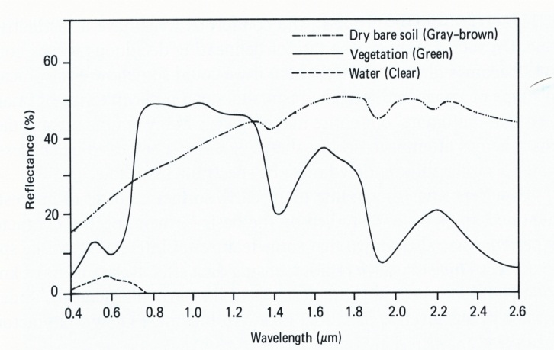
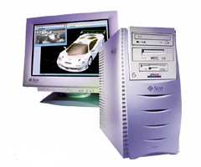
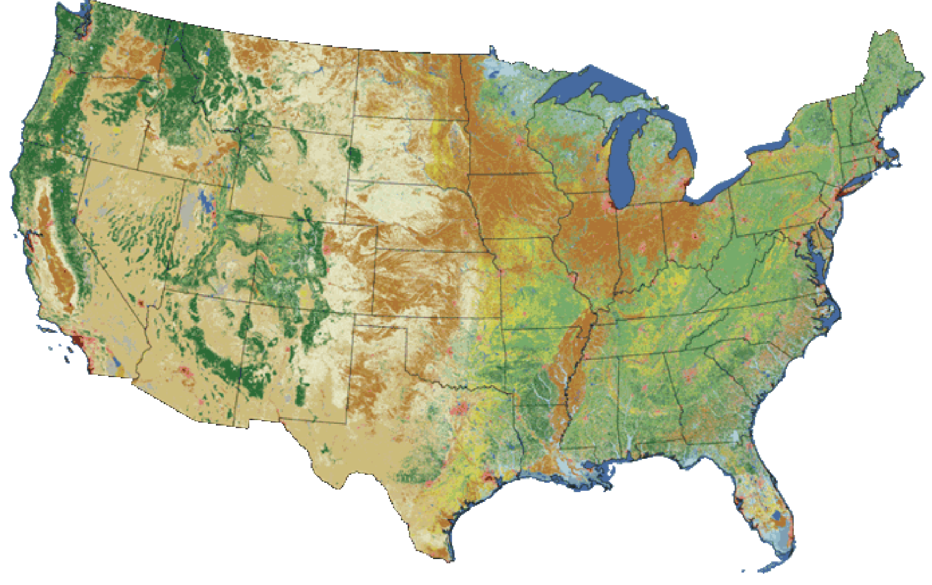
Remote Sensing Data Analysis
Land Cover map: use of remote sensing techniques
Notes:
definitions of categories and data collection methods by source agencies, incomplete data coverage, varying data age, and employment of incompatible classification systems

Slide 13
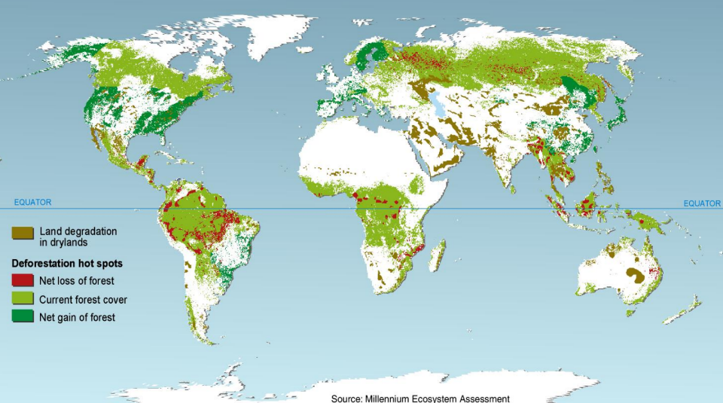
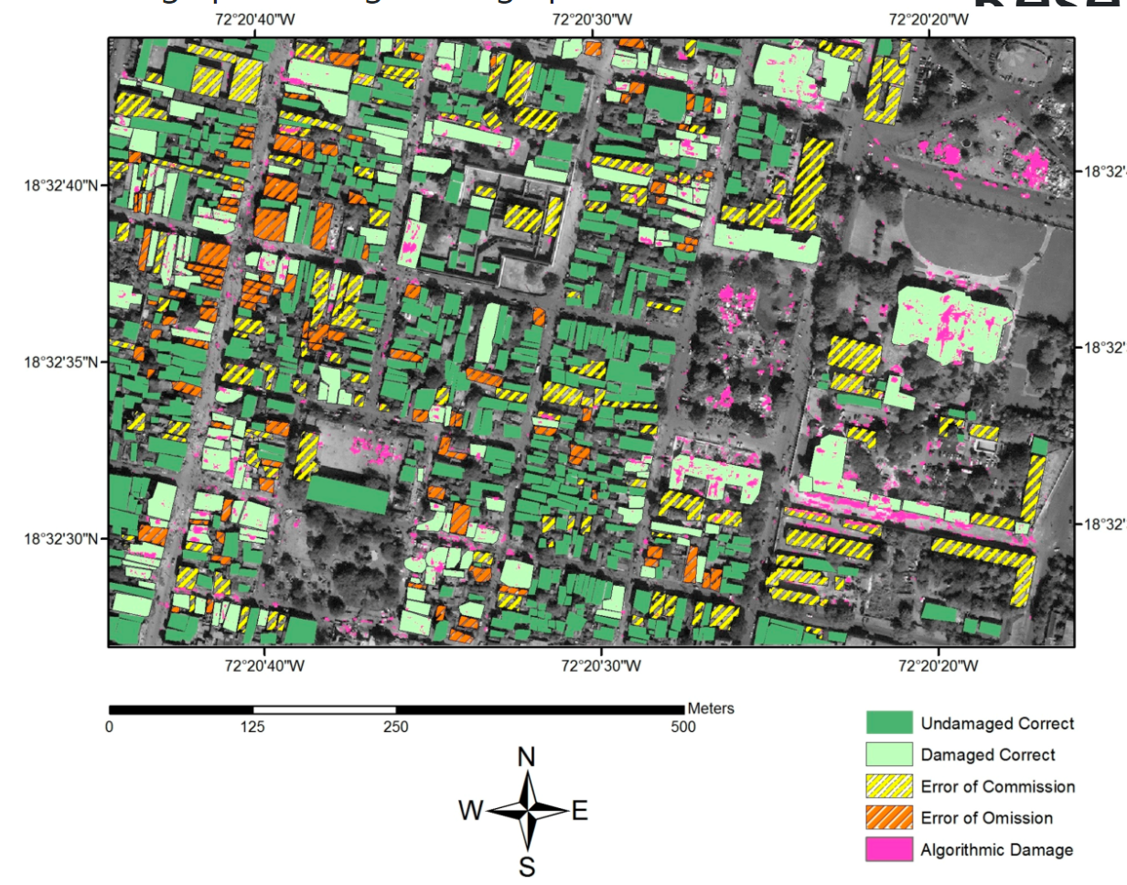
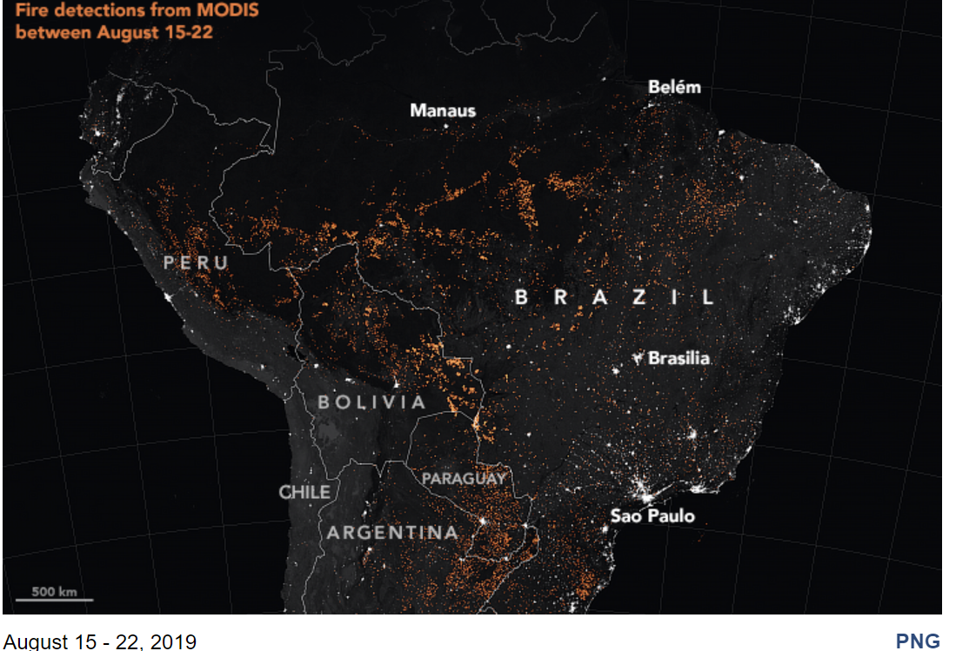
Remote Sensing-derived map products

Slide 14
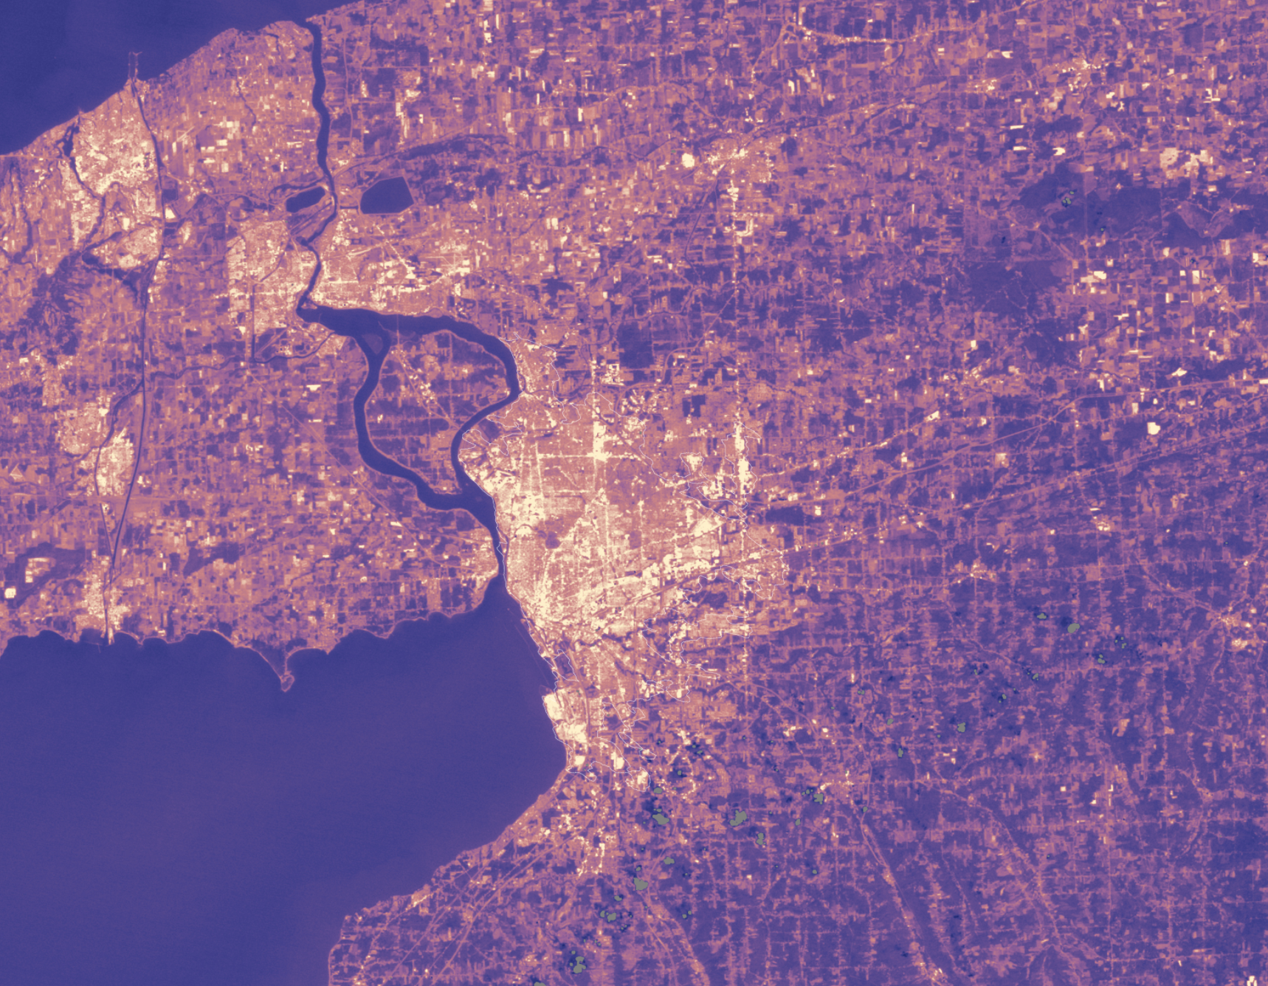
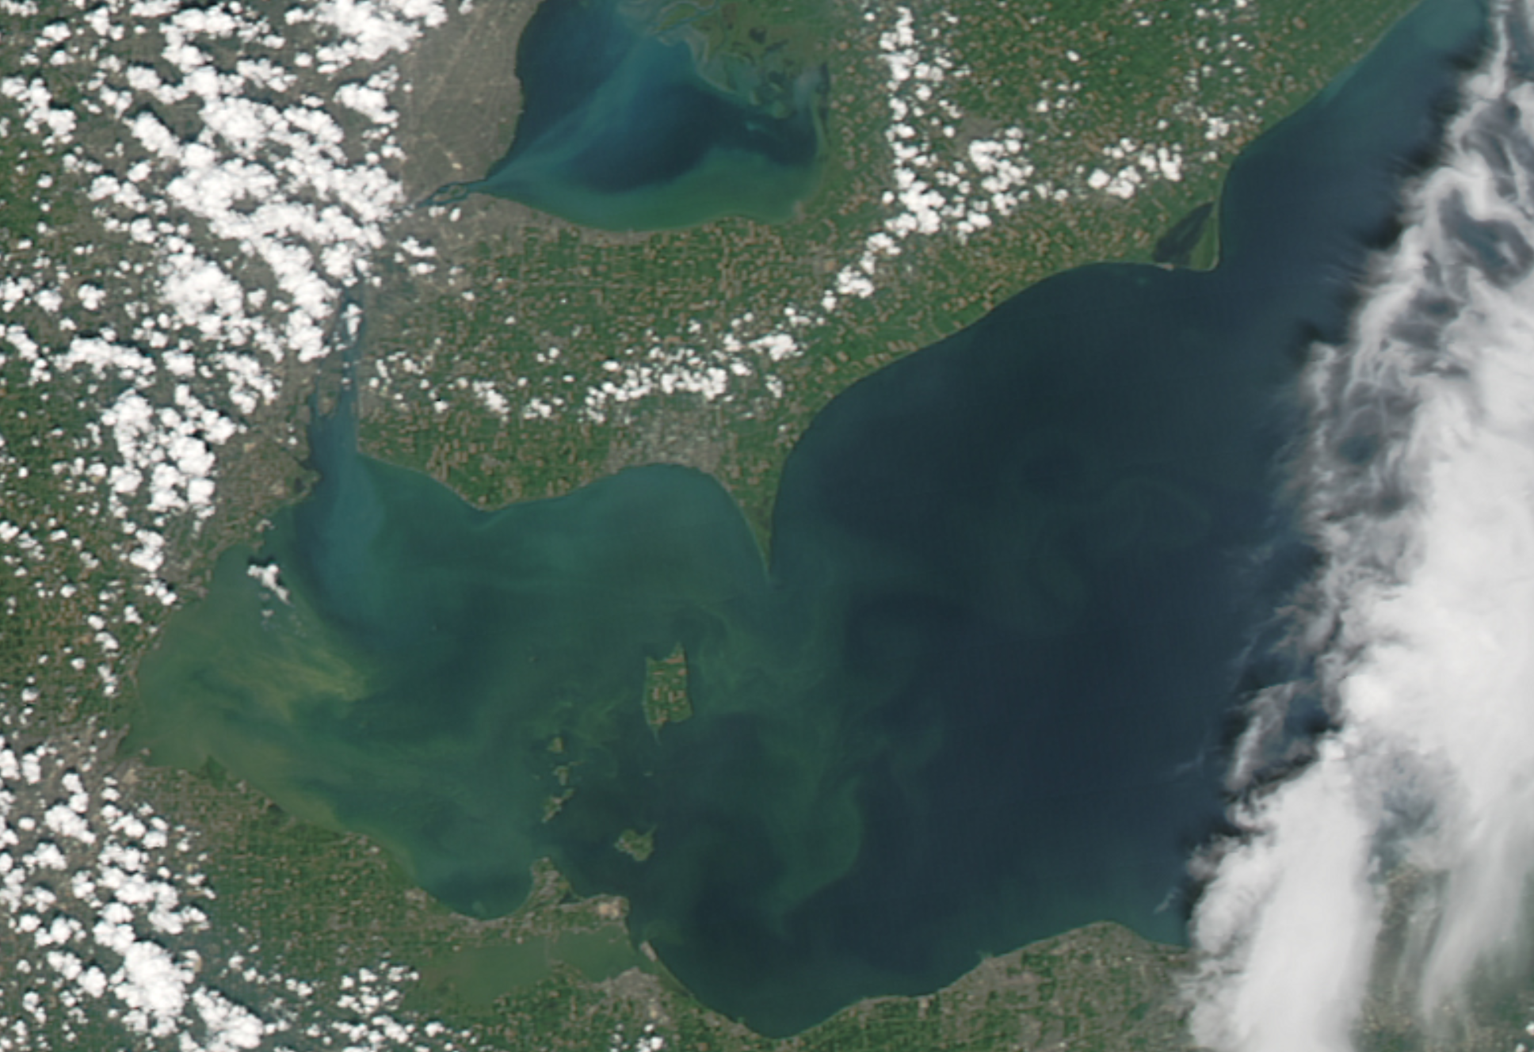
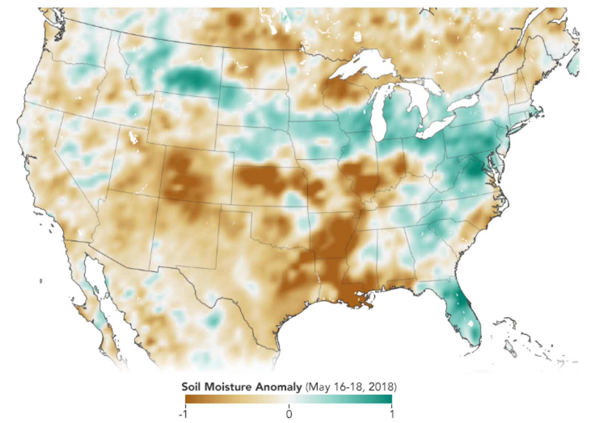
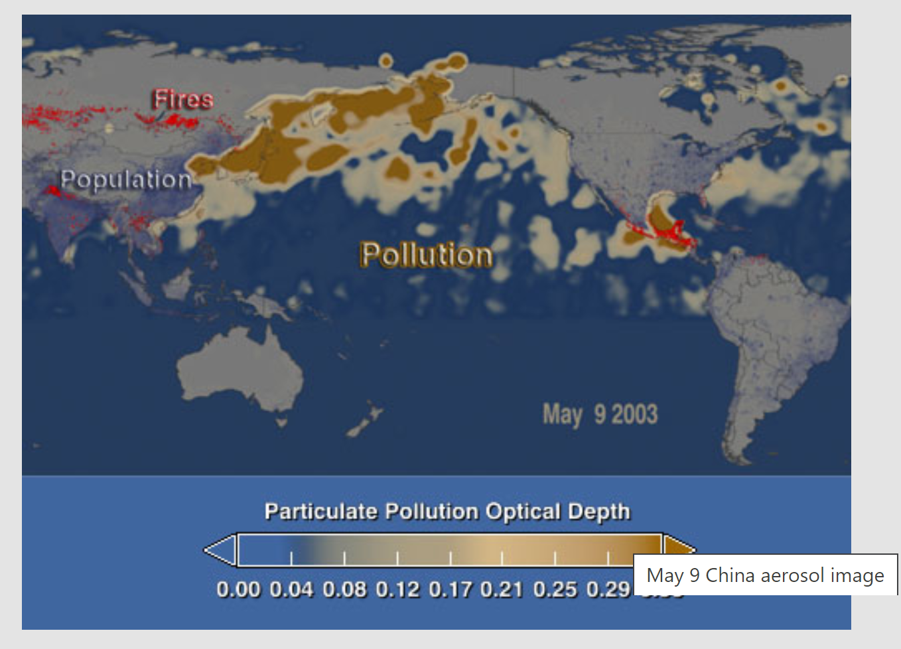
Urban surface temperature
Algae bloom mappping

Slide 15
Download Landsat data; Import data to Rstudio
Vegetation index (Normalized Difference Vegetation Index or NDVI)
Normalized Difference Water Index
Image classification (land cover mapping)

Slide 16
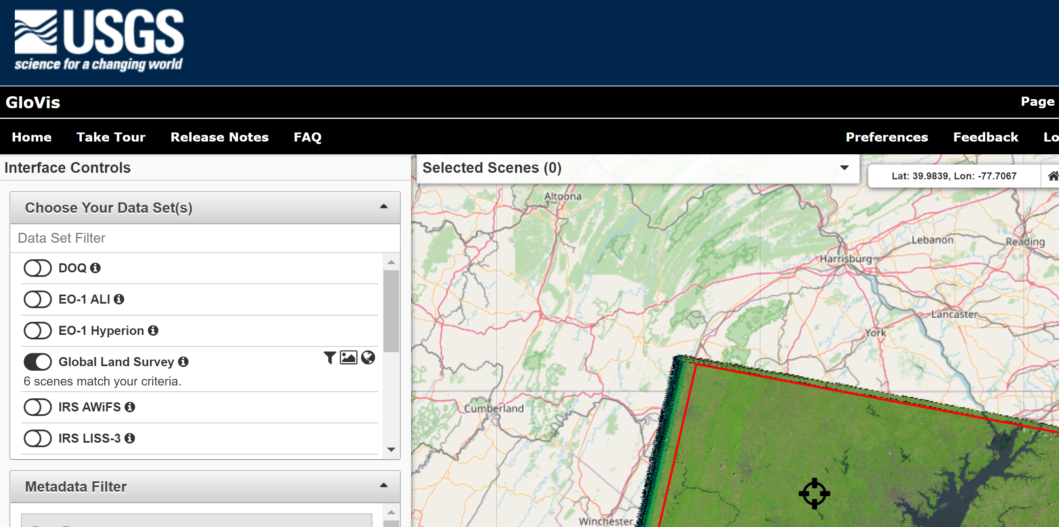
https://glovis.usgs.gov/app?fullscreen=0

Slide 17
Demo

Slide 18
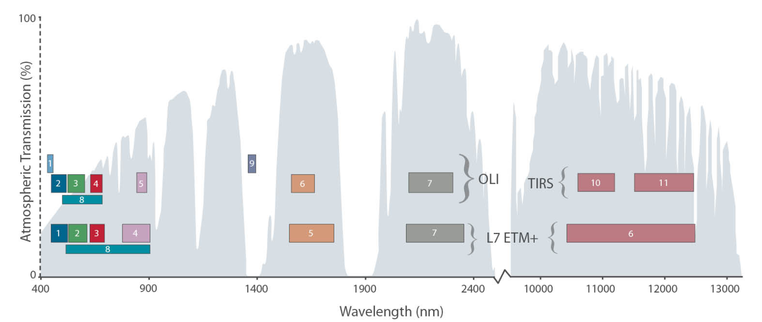
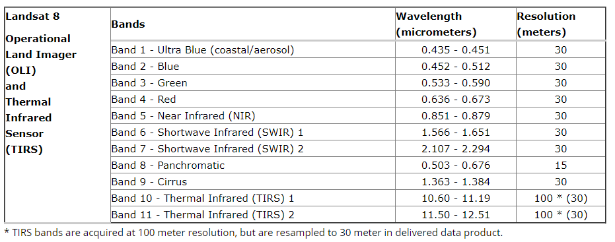

Slide 19
Download Landsat data; Import data to Rstudio
Vegetation index (Normalized Difference Vegetation Index or NDVI)
Normalized Difference Water Index
Image classification (land cover mapping)

Slide 20
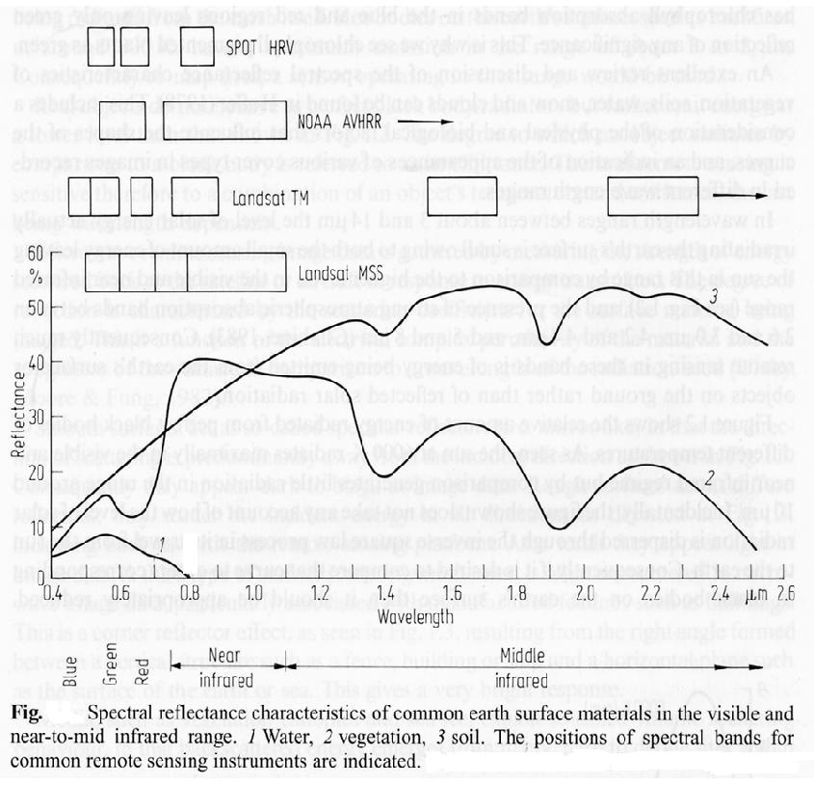
Vegetation Indices
Normalized Difference Vegetation Index (NDVI)
NDVI: [-1.0, 1.0]
Often, the more the leaves of vegetation present, the bigger the
contrast in reflectance in the red and near-infrared spectra.

Slide 21
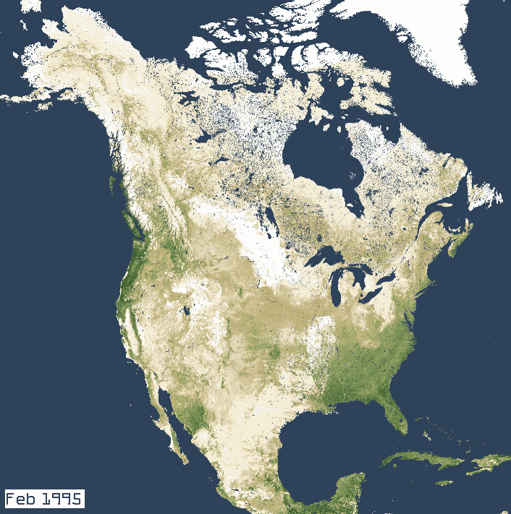
Normalized Difference Vegetation Index (NDVI)
NDVI =(NIR - R) / (NIR + R)
In Landsat 4-7, NDVI = (Band 4 – Band 3) / (Band 4 + Band 3)
In Landsat 8, NDVI = (Band 5 – Band 4) / (Band 5 + Band 4)

Slide 22
Normalized Difference Water Index
For Landsat 7 data,
NDWI = (Band 2 – Band 5) / (Band 2 + Band 5)
For Landsat 8 data,
NDWI = (Band 3 – Band 6) / (Band 3 + Band 6)

Slide 23
Download Landsat data; Import data to Rstudio
Vegetation index (Normalized Difference Vegetation Index or NDVI)
Normalized Difference Water Index
Image classification (land cover mapping)

Slide 24
Image classification approaches - computer-aided classification
Themes can vary (examples):
Urban, forest, ag, wetland, .. (NLCD)
Soil, vegetation, impervious surface, water
Computer algorithms (many)
- ML (Maximum Likelihood Classification)
- CART (Classification and regression trees)
- Random Forest Algorithm

Slide 25
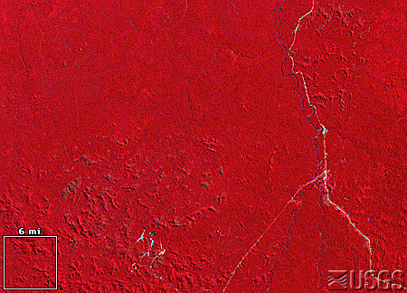
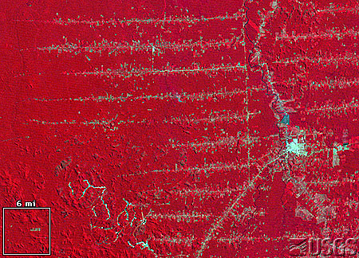
Image classification applications
Deforestation
Urban mapping and urban growth mapping
Coastal wetlands vegetation
Precision Agriculture
Identify invasive species
..

Slide 26
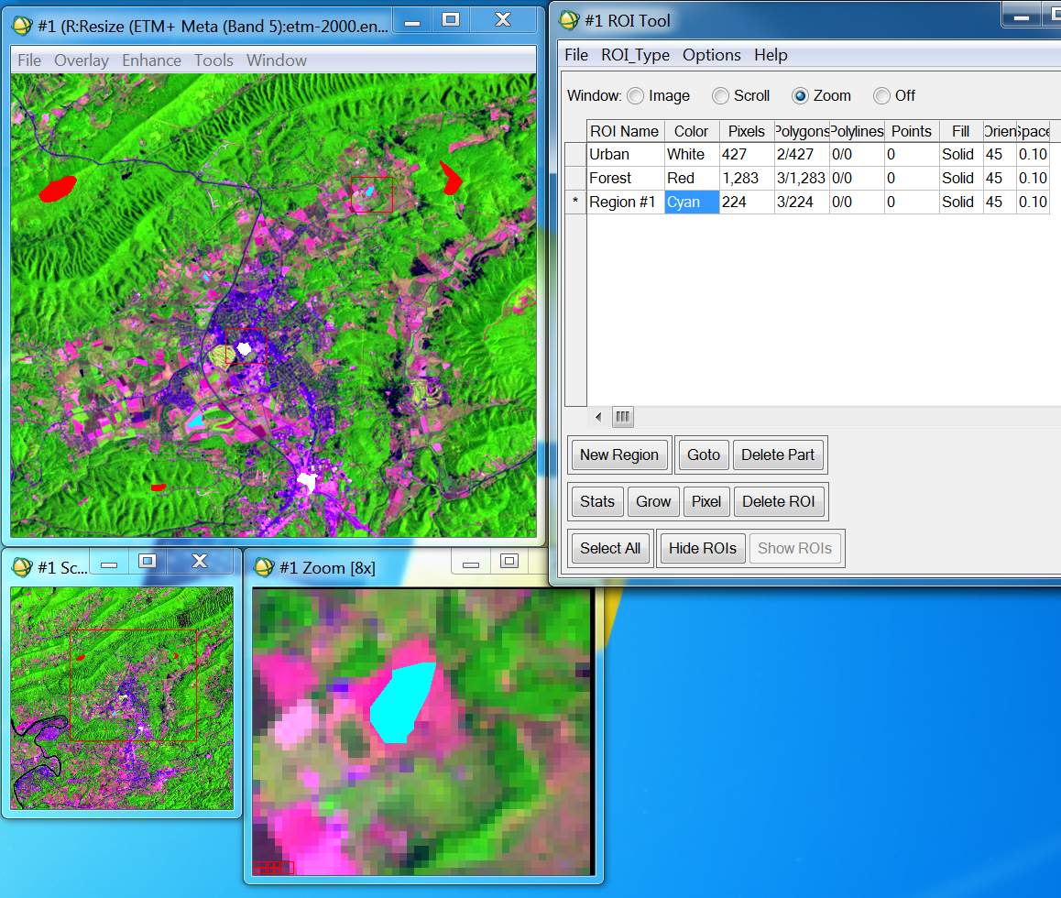
Supervised Classification Algorithms
Users provide the computer with some examples (training pixels)
of known features in multi-dimensional feature space.

Slide 27
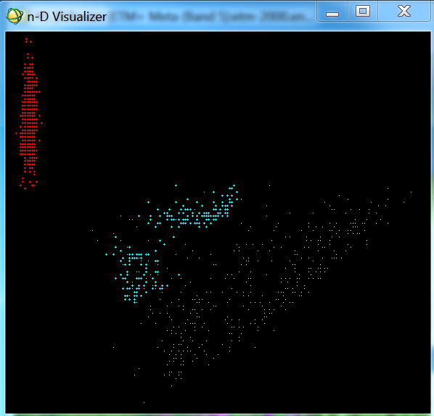
Supervised Classification Algorithms
Forest
Ag
Band 4
Generate statistics
for supervised classification
Urban
Band 3

Slide 28
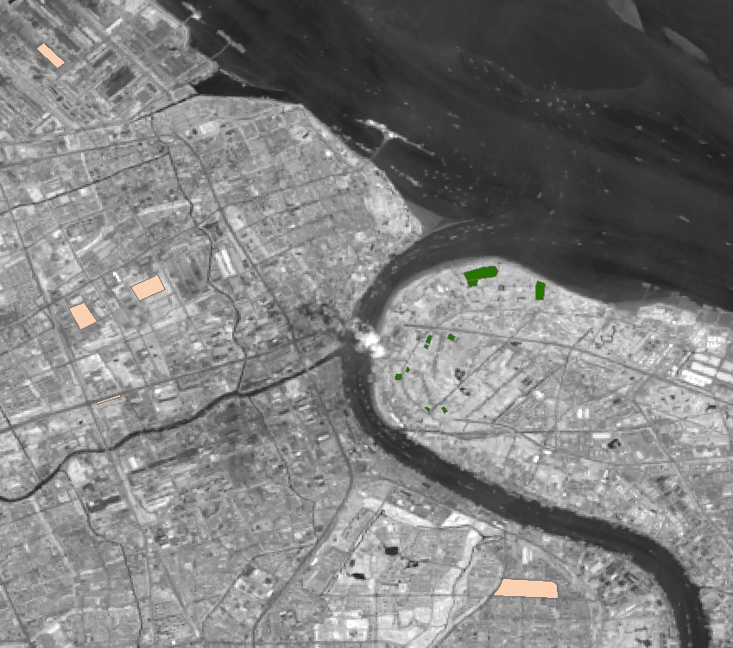
Twoclass.shp (urban and forest polygons)

Slide 29
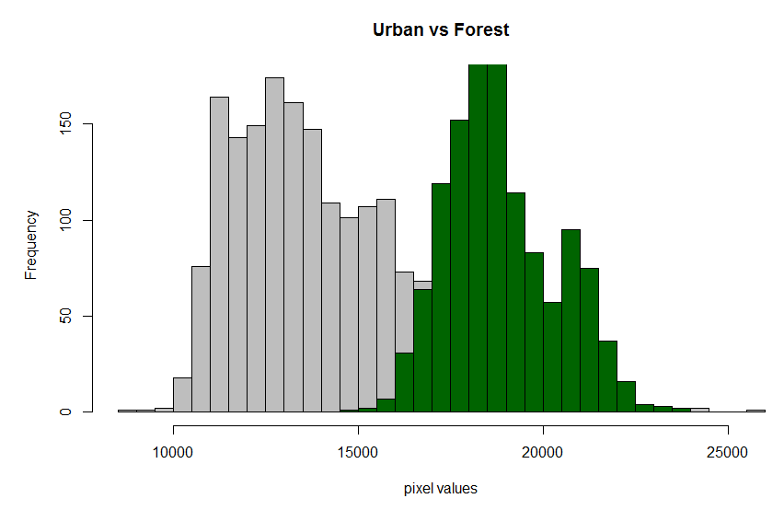

Slide 30
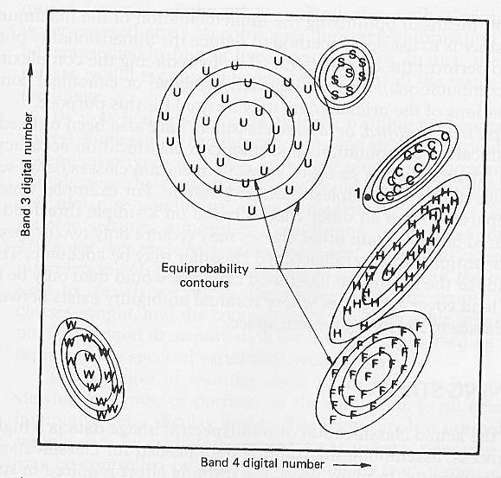
Maximum Likelihood Classification
In a two dimensional spectral space, each class form a probability density region,
the probability for a pixel belongs to a center category is defined by its distance
measured in standard deviation. The pixel is assigned a class that is most likely
(maximum likelihood).
Disadvantages: Large number of computations, particularly many spectral bands
are involved.

Slide 32
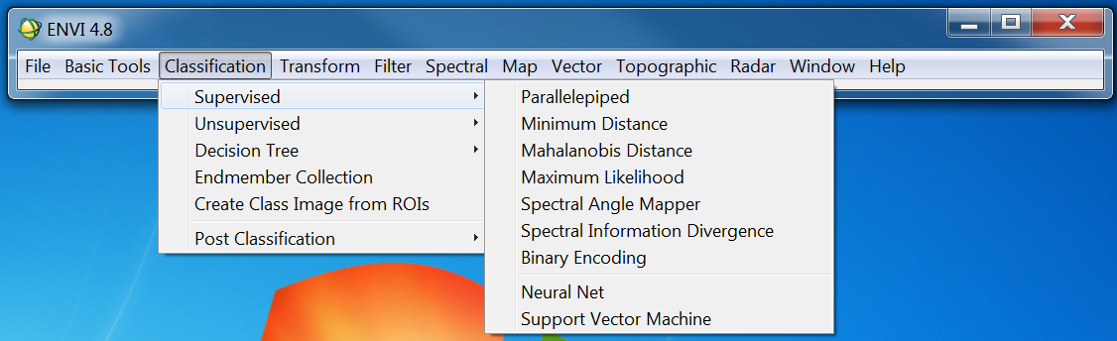
Supervised Classification Algorithms in ENVI

Slide 33
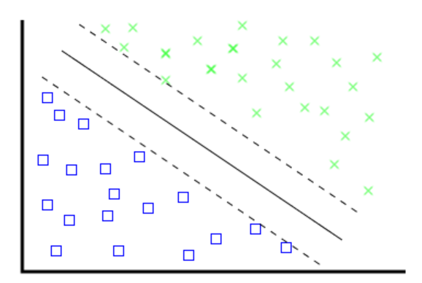
Test different image classification algorithms
Forest
Non-forest
Neural Networks
Classification and Regression Tree
Random Forest
Support Vector Machine
Weights
Weights
Band4
Band1
Band2
…．
Band3
Band4
Band4>95
Class1
Class2
Band3<50
CART
SVM

Slide 34
Image classification (land cover mapping)
Training data polygons (e.g., urban, forest, ag…)
Landsat image
Classcode (y) | Band3 (red) | Band4 (nir)
1 | 13000 | 15000
1 | 12500 | 18321
2 | 9800 | 4560
2 | 9832 | 4780
1 | 14500 | 19200
1 | . | .
1 | . | .
1 | . | .
1 | . | .
1 | . | .
1 | . | .
3 | . | .
3 | . | .
3 | . | .
1 | . | .
1 | . | .
Dataframe of training data
Y~ f(x)
(classification problem,not a regression)

Slide 35
Twoclass.shp (urban and forest polygons)

Slide 36
Make predictions for all pixels
Classcode (all pixels) | band1 | band2
? | 14000 | 12000
? | 13500 | 18521
? | 1900 | 3560
? | 4832 | 3780
? | 4500 | 9200
? | . | .
 | . | .
 | . | .
 | . | .
 | . | .
 | . | .
 | . | .
 | . | .
 | . | .
 | . | .
 | . | .
Y~ f(x)
(classification problem,not a regression)

Slide 37
Twoclass.shp (urban and forest polygons)

Slide 38
Rscript and demos

